Slide 1
Capstone Project 2 - Automated Fault Detection and Diagnosis (AFDD) of HVAC Systems
Wei Ruan
Springboard Data Science Student 2022-2023

Slide 2
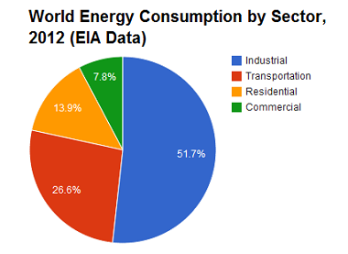
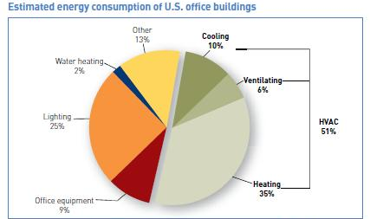
Problem statement
U.S. Energy Information Administration data
U.S. Energy Information Administration data
Goal of this project – develop a data-driven AFDD scheme for air handling units (AHUs) with the precision of over 80% to detect common faults of HVAC.
Notes:
The energy consumption in the building sector accounts for approximately 20-40% of the total energy consumption, and heating, ventilation, and air conditioning (HVAC) systems consume approximately 50-60% of the total energy consumed by the buildings.
This project will develop a data-driven AFDD scheme for air handling units (AHUs) with the precision of over 80% to detect common faults of HVAC, which will detect faults early that could be repaired to save energy, improve the reliability and thermal comfort of buildings

Slide 3
Dataset
Generated by LBNL
DOE large office reference building
3 types of AHUs:
Multi-zone AHU (MZAHU)
single zone AHU (SZAHU)
Roof top AHU (RTU)
Faults: 3 faults for MZAHU, 2 faults for SZAHU, 1 fault for RTU

Slide 4
Fault investigated
OAT Sensor offset 2 °F higher
Data Point Summary
1-min interval
System setpoints
Control signals
Actual measurements
Schedule Points
Truth Points

Slide 5
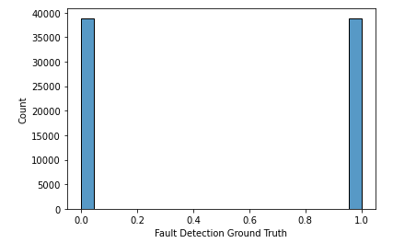
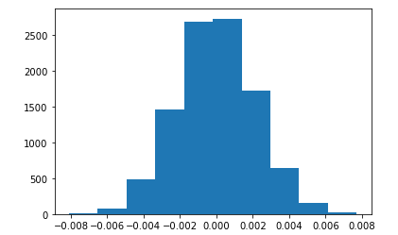
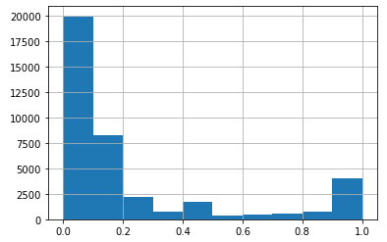
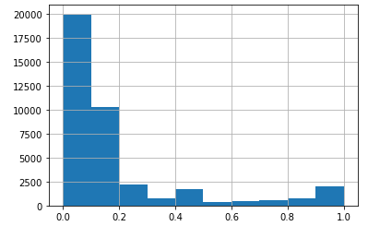
Exploratory Data Analysis (EDA)
Normal and Fault almost equal
OA damper control signal (0-1) dist.
OA damper signal difference dist.
Statistical hypostasis test p < 0.0005 that this fault does impact the OA damper control signal.
OA damper signal difference
Normal Conditions
Fault Conditions

Slide 6
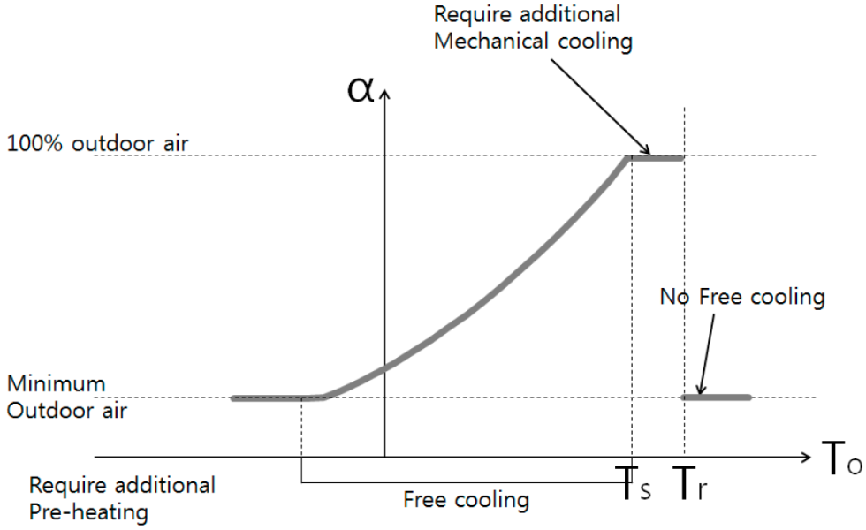
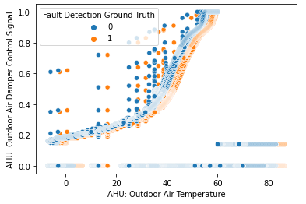
Exploratory Data Analysis (EDA)
Control sequence of OA damper signal
During the experiments, most of time OA damper at free cooling mode
Fault conditions orange points shift 2 °F to right than the blue (normal) points.
Theoretical OA damper signal
Normal and Fault: OA damper signal

Slide 7
Pre-processing
Data split as train and test data
One-hot encode all features
Fitting data to the scaler object

Slide 8
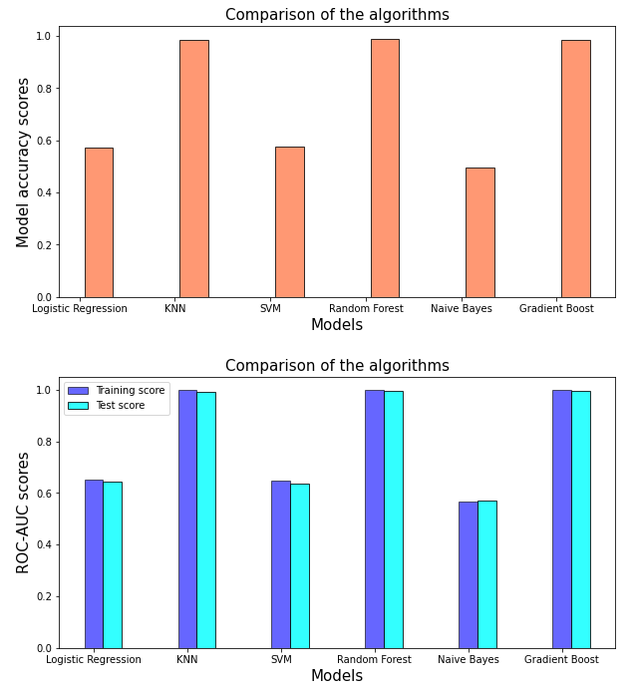
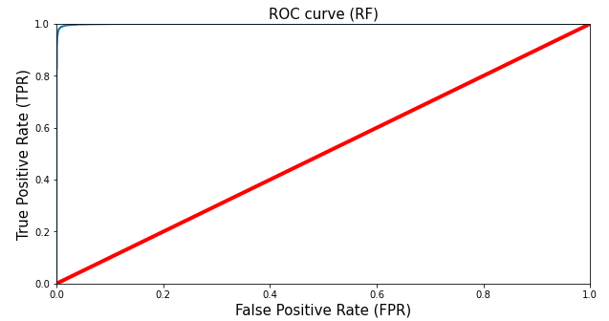
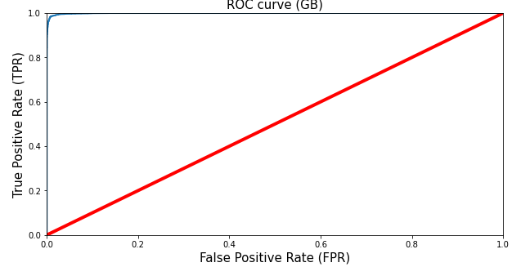
Modeling
6 ML classification models
Logistic regression
KNN
SVM
Random Forest
Naive Bayes
Gradient Boost
Model scores comparison
(a) model accuracy scores (b) ROC-AUC
ROC curves based on ML models
(a) model accuracy scores (b) ROC-AUC

Slide 9
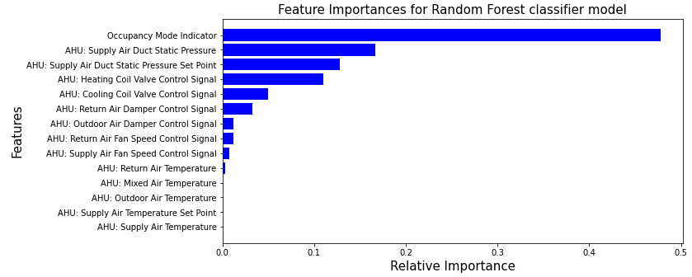
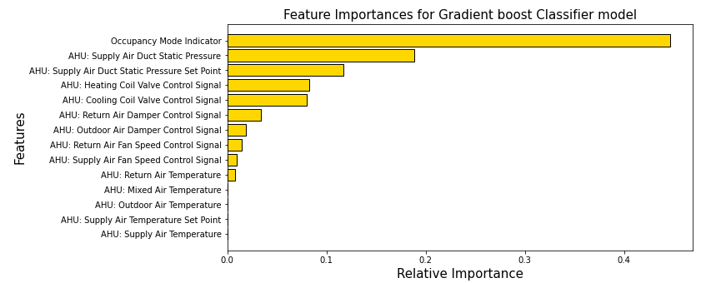
Feature Importance Rank
Feature importance rank by
Random Forest
Gradient Boost
Ranks are same order and similar importance
Feature ranking based on ML models (a) Random Forest (b) Gradient Boost

Slide 10
Takeaways
Two best performing models are the Random Forest and the Gradient Boost.
Both are the ensemble model, based on decision trees.
Grid Search CV for the hyperparameter tuning
Model performance improved with the optimized parameters
The final ROC-AUC scores for both RF and the GB are 0.99941 and 0.99916
Notes:
Six ML classification models were evaluated. The two best performing models are the Random forest and the Gradient boost. Both are the ensemble model, based on decision trees.
Next, we have carried out the grid search CV for the hyperparameter tuning for both the models separately. This step was the most time consuming one in terms of computation. (The RF model took much longer time). With the result of the optimized hyperparameters, we have again fitted the two models, and got the predictions separately.
We have evaluated the ROC-AUC scores with the optimized hyperparameters. Clearly, the model performance improved with the optimized parameters. The final ROC-AUC scores for both RF and the GB are 0.99941 and 0.99916

Slide 11
Future Research
Implement AFDD models into the real applications
A real fault vs a simulated faults
Feasibility of using these models for other AHUs
Do we need to train and test on other AHUs?
Detecting the root causes
Diagnosing a single fault
Diagnosing integrated faults
Feature ranking based on ML models (a) Random Forest (b) Gradient
Notes:
This project enlightened me on the classification models to detect faults in the air handling units for a large office building. While my models were valuable to this specific project or the dataset that were built by experiments and simulation, it is difficult to say how useful they would be in the real application if one fault occurs. We would like to know how much data is needed to detect a single fault.
The faults in this project were mimicked by experiments or simulation. If a single fault is not steady or stable, it is interesting if the models developed in this project are applicable. Furthermore, we would like to know how the models respond to the multi faults occurring at the same time.
Finally, the current classification models were developed for fault detection. A question will arise: how to diagnose a single fault or integrated faults in the real application. Especially for the integrated faults, how to decouple the faults and find the root cause will be more challenging.

